Slide 1
Faculty Senate
February 23, 2016
Dr. Robert J. Marley
Provost and Executive Vice Chancellor for Academic Affairs

Slide 2
Recent NSF CAREER Awardees:
Dr. Caizhi Zhou, Materials Science and Engineering
Dr. Jie Gao, Mechanical and Aerospace Engineering

Slide 3
Receiving the 2016 Excellence Award:
Mehdi Ferdowsi, Electrical & Computer Engineering
Kelly Liu, Geosciences and Geological and Petroleum Engineering
Joshua Rovey, Mechanical and Aerospace Engineering
Lesley Sneed, Civil, Architectural and Environmental Engineering
Receiving the 2016 Achievement Award:
Lorie L. Francis, Arts, Languages, and Philosophy
Merilee A. Krueger, Psychological Science
Honglan Shi, Chemistry
Theresa Swift, Electrical and Computer Engineering
Kelly J. Tate, English and Technical Communication
Terry Wilson, Biological Sciences

Slide 4
Receiving the 2016 Research Award:
Mohsen Asle Zaeem, Materials Science and Engineering
Kyle DeMars, Mechanical and Aerospace Engineering
Robert Landers, Mechanical and Aerospace Engineering
Mingzhen Wei, Geosciences and Geological and Petroleum Engineering
Yahong Rosa Zheng, Electrical and Computer Engineering
Receiving the 2016 Service Award:
Petra DeWitt, History & Political Science
Stephen Gao, Geosciences and Geological and Petroleum Engineering
Steve E. Watkins, Electrical and Computer Engineering

Slide 5
Receiving the 2016 Teaching Award:
Petra DeWitt, History & Political Science
Kelvin Erickson, Electrical and Computer Engineering
Stephen Gao, Geosciences and Geological and Petroleum Engineering
Amber Henslee, Psychological Science
J. Keith Nisbett, Mechanical and Aerospace Engineering
Dev K. Niyogi, Biological Sciences
Kathleen Sheppard, History & Political Science
J. Greg Story, Physics
Experiential and Service Learning Awards
(Awarded by Undergraduate Studies)
Norbert Maerz, Geosciences and Geological and Petroleum Engineering - Experiential Learning Award
Brett Watson, Student Life - Experiential Learning Award
Sarah Stanley, Business and Information Technology – Service Learning Award

Slide 6
Enrollment/Net Ranked Faculty Headcount
Vacant lines not included

Slide 7
QUESTIONS?

Slide 8
Division Updates
Faculty Senate Meeting
Thursday, February 23, 2017

Slide 9
Enrollment Management
Thanks to all who helped with the February 20 Open House and the VEX Robotics State Championship
February 25 – First PRO Day for Fall 2017 freshmen
Upcoming events that we are hosting on campus
February 23-25 – Out of State High School Counselor Fly-in
March 4 – FIRST Robotics State Championship

Slide 10
College of Arts, Sciences, and Business
Shannon Fogg’s (History and Political Science) new book, Stealing Home: Looting, Restitution, and Reconstructing Jewish Lives in France, 1942 – 1947 was released by Oxford Press this month.
Denise Baker (Psychological Science) and co-PI Simone Silvestri have been awarded $802,981 by the National Institute of Food and Agriculture for their project entitled, “Integration of Social Behavioral Modeling for Smart Environments to Improve Energy Efficiency of Smart Cities.”
Devin Burns (Psychological Science) and co-PI Sajal Das have been awarded $67,910 for their project entitled, “STTR Phase I: Advanced and Remote Screening Monitoring and Rehabilitation of Cognitive Health.”

Slide 11
College of Arts, Sciences, and Business
Bonnie Bachman (Economics) has been awarded $100,000 by Missouri Technology Corporation for her project entitled, “Building a statewide I-Corps Site Program.”
Fiona Nah (Business and Information Technology) has been awarded $74,163 by New Jersey Institute of Technology for her project entitled, “Factoring Human Behavior into Design of Human-Computer Interface to Convey Cybersecurity.”
Honglan Shi (Chemistry) has been awarded $21,136 by Pegasus Technology Services, Inc. for her project entitled, “Analysis of Multi-Walled Carbon Nanotube Released from Polymer Matrix using SP-ICP-MS.”
Devin Burns (Psychological Science) and co-PI Sajal Das have been awarded $67,910 for their project entitled, “STTR Phase I: Advanced and Remote Screening Monitoring and Rehabilitation of Cognitive Health”.

Slide 12
College of Engineering and Computing
Dr. Braden Lusk, chair and professor of mining and nuclear engineering, was recently named to the National Academy of Sciences, Engineering and Medicine’s Committee on Surface Coal and Human Health.
Caizhi Zhou’s, Couch Assistant Professor of Materials Science & Engineering, NSF CAREER Award on “Understanding Interface-Mediated Deformation in Layered Composites through Modeling and Experiment.
Dr. Mohsen Asle Zaeem, assistant professor of materials science and engineering, has been named the Young Leaders International Scholar by The Minerals, Metals and Materials Society (TMS) and the Federation of European Materials Societies (FEMS).

Slide 13
College of Engineering and Computing
Dr. Heng Pan, assistant professor of mechanical and aerospace engineering, was interviewed for an article, “3D Printing Has Potential to Create Wearable, Stretchable Electronic Devices,” by Laura Panjwani that was published Jan. 18 on the R&D Magazine site.
Dr. Harlan Anderson, Curators’ Professor Emeritus of Ceramic Engineering, recently received the High Temperature Materials Division Outstanding Achievement Award from the Electrochemical Society.
Dr. Joel Burken, Curators’ Distinguished Professor and chair of civil, architectural and environmental engineering at Missouri University of Science and Technology, has been selected to serve on the U.S. Environmental Protection Agency’s Science Advisory Board (SAB). Burken, who has also served as the director of the Environmental Research Center at Missouri S&T, will serve as “a special government employee” through Sept. 30, 2019.

Slide 14
Office of Undergraduate Studies
Concurrent Enrollment pilot program with ECC was approved by MDHE and will begin in fall 2017.
There are seven Honors Academy Fellows will graduate in May 2017.
The foundation for the 2017 S&T Solar House is being poured and the construction on the newest entry will begin soon (Department of Energy Solar House competition is in October in Colorado).

Slide 15
Office of Graduate Studies
Degrees awarded for FS 2016:
169 Certificate
254 Master’s
30 Doctorate
Doctoral Student Recruitment Grants
5 proposals awarded
Chancellor’s Distinguished Fellowship
24 Nominations (8 spots available)
Awardees and departments will be notified of decisions in early March
Graduate Fellows Poster Session on Feb. 27, St. Pat’s
Chancellor’s Fellows and Chancellor’s Distinguished Fellows participate in this research poster session.
Mini Thesis/Dissertation Boot Camp
March 2&3, 9am-4pm, Havener
Students should register in the Office of Graduate Studies
Graduate Leadership Development Program (GLDP)
8 students in 2017 cohort
Starting at Mizzou Feb 23-24

Slide 16
Office of Sponsored Programs
Summary of FY17 activities year-to-date (December)
Number of funded proposals is down by 6% for a total of 145
Total dollars is $16M which is down by 9%
Number of new proposals submitted is up 11% for a total of 290
Total dollars is $74M which is down by 3%
Number of active awards is up by 2% at 603
Total expenditures is $20M which is up by 4%
Net grant and contract expenditures is $15M which is up by 5%
F&A recovered is $3M which is up by 6%

Slide 17
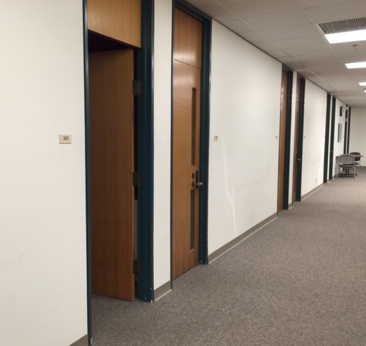
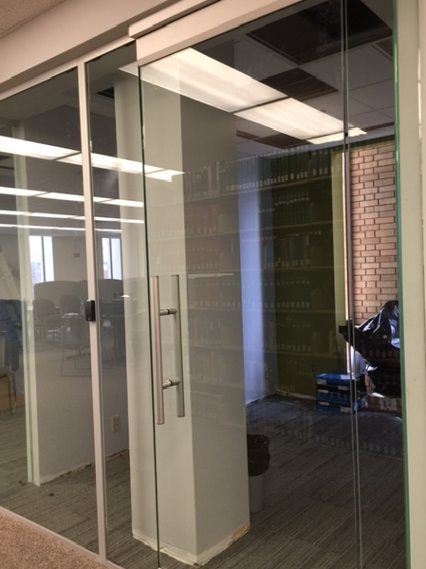
Curtis Laws Wilson Library
Four new study rooms online, end of February
After:
Glass fronts for more light (but maintain aural privacy)
Monitors/Clickshares, entire wall as whiteboard
Before: At best, blah…

